Slide 1

VHDL (Libraries, Subprogram, Packages)
Winter 1400 (Computer Aided Design)
Meisam Abdollahi
School of Computer Engineering
Iran University of Science and Technology
meisam.abdolahi@ut.ac.ir

Slide 2
Outline
Libraries
Packages
Subprograms
Procedures
Functions
Data type conversion

Slide 3
Packages & Libraries
Frequently used pieces of VHDL code are usually written in the form of COMPONENTS, FUNCTIONS, or PROCEDURES.
Such codes are then placed inside a PACKAGE and compiled into the destination LIBRARY
A package can be shared across many VHDL models.
A package can also contains user defined data types and constants.
A library is a collection of related packages.
Packages and libraries serve as repositories for functions, procedures, and data types.

Slide 4
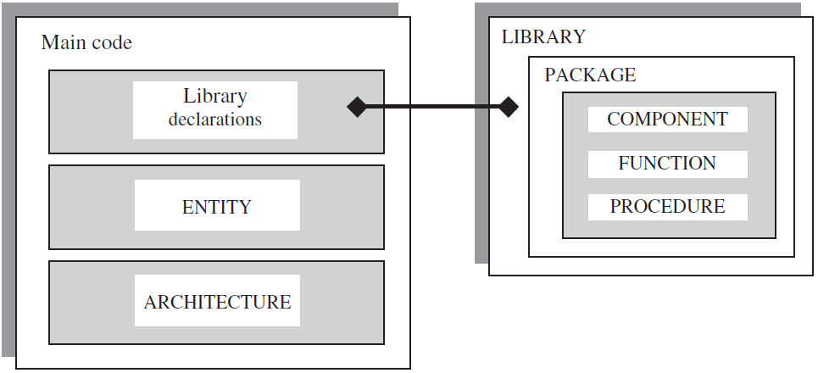
Packages & Libraries

Slide 5
Libraries
Library is a place to which design units may be compiled.
Two predefined libraries are the STD and WORK libraries.
WORK and STD: you don’t need to call it.
IEEE standard library contains the IEEE standard design units. (e.g. the packages: std_logic_1164, numeric_std).

Slide 6
Libraries (cntd.)
VHDL knows library only by logical name
A library is made visible using the library clause.
Library ieee;
In standard VHDL both work and std libraries are visible

Slide 7
Libraries (cntd.)
LIBRARY std; (do not need to call)
Contains the following packages
Standard (Types: Bit, Boolean, Integer, Real, and Time. All operator functions to support types)
Textio (File operations)

Slide 8
Libraries (cntd.)
LIBRARY ieee; (need to call)
Contains the following packages:
std_logic_1164 (std_logic types & related functions)
std_logic_arith (arithmetic functions)
std_logic_signed (signed arithmetic functions)
std_logic_unsigned (unsigned arithmetic functions)

Slide 9
Libraries (cntd.)
How to call a library
LIBRARY <any_name>;
USE <any_name>.<package_name>.all;
Example
LIBRARY ieee;
USE ieee.std_logic_1164.all;

Slide 10
Packages

Slide 11
Packages
A VHDL package is simply a way of grouping a collection of related declarations that serve a common purpose
Allows data types, subprograms, object declarations (signal, constants, shared variables and files), component declarations etc. to be shared by multiple design units.
Syntax
package identifier is
declarations
end [package] [identifier];
Example
package my_package is
type binary is (onn, off);
signal a: std_logic_vector(3 downto 0);
constant pi : real := 3.14;
function Min1 (X, Y : Integer range 0 to 30) return Integer;
end my_package;

Slide 12
Package body
The package declaration contains only the declarations of the various items
The package body contains subprogram bodies and other declarations not intended for use by other VHDL entities
Example
package body my_package is
function Min1 (X, Y : Integer range 0 to 30) return Integer is
variable temp : integer range 0 to 30;
begin
if (X < Y) then
temp:= X;
else
temp:= Y;
end if;
return temp;
end Min1;
end my_package;

Slide 13
Package
How to use?
A package is made visible using the use clause.
use work.my_package.binary, my_package.Min;
... entity declaration ...
... architecture declaration ...
use the binary and Min declarations only
use work.my_package.all;
... entity declaration ...
... architecture declaration ...
use all of the declarations in package my_package

Slide 14
Subprograms

Slide 15
Subprograms
Subprograms are of two types :
functions and procedures
A subprogram consists of a sequence of declarations and statements which can be repeated from different locations in VHDL descriptions
A subprogram can be separated into its subprogram declaration and subprogram body

Slide 16
Subprograms
Full form of subprogram body is
subprogram-specification is
declarations
begin
statements
end identifier;

Slide 17
Functions

Slide 18
Subprograms (Functions)
A function computes and returns a value of specified type using the input parameters.
Can be defined locally to an architecture or more commonly in a package
Function parameters can only be inputs and they cannot be modified.
i.e., you cannot change the value of inputs inside the function body
Functions are restricted to substitute components with only one output
Statements within a function must be sequential.

Slide 19
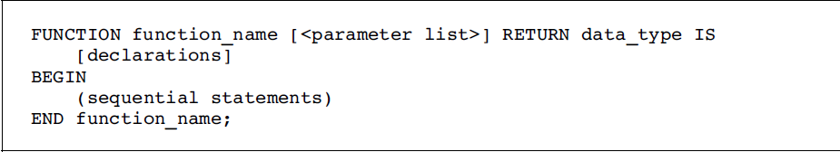
Function (Syntax)
<parameter list> specifies the function’s input parameters
<parameter list> = [CONSTANT] constant_name: constant_type;
<parameter list> = SIGNAL signal_name: signal_type;
VARIABLES are not allowed
No range specification should be included
do NOT enter RANGE when using INTEGER, or TO/
DOWNTO when using STD_LOGIC_VECTOR
However, you can use range as well, but it is better to avoid it

Slide 20
Functions (II)
Function declaration:
function rising_edge(signal clock: in std_logic) return Boolean;
function rising_edge(signal clock: std_logic)
return Boolean is
--
-- declarative region: declare variables local to the function
--
begin
--
-- body
--
return (value);
end function rising_edge;

Slide 21
Functions (III)
FUNCTION f1 (a, b: INTEGER; SIGNAL c: STD_LOGIC_VECTOR)
RETURN BOOLEAN IS
BEGIN
(sequential statements)
END f1;
a and b are CONSTANTS (notice that the word CONSTANT can be omitted,
for it is the default object),
c is a SIGNAL
Notice that neither RANGE nor DOWNTO was specified

Slide 22
Functions (IV)
The function is called with the actual parameters.
Example: rising_edge(enable);
Types of formal and actual parameters must match.
Actual parameters could be signal, constant or an expression.
WAIT, SIGNAL declarations, and COMPONENTS are not synthesizable when used in a FUNCTION.
Wait statements, signal declarations and components cannot be used in functions’ body.
Parameters have to be mode in.

Slide 23
Function call (Examples)
x <= conv_integer(a); -- converts a to an integer
y <= maximum(a, b); -- returns the largest of a and b
IF x > maximum(a, b) ... -- compares x to the largest of a, b
expression appears by itself

Slide 24
Function: Examples (I)
function Min (X, Y : Integer) return Integer is
variable temp : integer;
begin
if (X < Y) then
temp:= X;
else
temp:= Y;
end if;
return temp;
end Min;
function inc (a: bit_vector) return bit_vector is
variable s: bit_vector (a'range);
variable carry: bit;
begin
carry := '1';
for i in a'low to a'high loop
s(i) := a(i) xor carry;
carry := a(i) and carry;
end loop
return (s);
end inc;

Slide 25
Pure vs. Impure Function

Slide 26
Pure vs. Impure Function
[pure | impure] function identifier [( parameter_interface_list )]
return type_mark is
{ subprogram_declarative_item }
begin
{ sequential_statements }
end [ function ] [ identifier ];

Slide 27
Pure vs. Impure function (I)
By default, functions are declared as pure;
In pure functions, the only accessible data are the input arguments; and the only returned information from this function is the returned value. Pure functions do not have access to objects outside the function.
VHDL’93 introduces impure declaration;
Impure functions must be explicitly declared;
Impure functions can modify data outside their own scope.

Slide 28
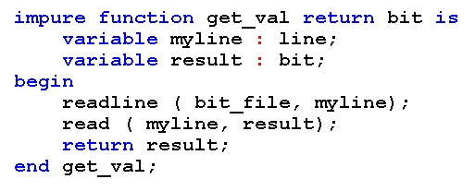
Pure vs. Impure function (II)
Example:
The file bit_file is an outside object.
Since the function is impure, accessing to the file bit_file is possible.

Slide 29
Function Location

Slide 30
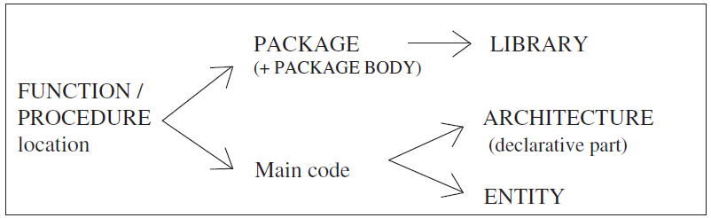
Function Location
Function is usually placed in a PACKAGE (for code partitioning,
code reuse, and code sharing purposes)
When placed in a PACKAGE, then a PACKAGE BODY is necessary, which must contain the body of each FUNCTION
Function can also be located in the main code (either inside the ARCHITECTURE or inside the ENTITY).

Slide 31
Function: Examples (Locate inside arch.)
library IEEE;
use IEEE.std_logic_1164.all;
entity dff is
port(d, clock: in std_logic; q, qbar: out std_logic);
end entity dff;
architecture beh of dff is
function rising_edge(signal clock:std_logic) return Boolean is
variable edge: Boolean:=FALSE;
begin
edge:= (clock = ‘1’ and clock’event);
return (edge);
end function rising_edge;
begin
output: process is
begin
wait until (rising_edge(clock));
q <= d after 5 ns;
qbar <= not d after 5 ns;
end process output;
end architecture beh;
Declarative part of
architecture
Either True or False

Slide 32
Function: Examples (Locate inside Entity)
library ieee;
use ieee.std_logic_1164.all;
entity test is
port(a,b: in integer;
C: out integer);
function Min (signal X, Y : Integer) return Integer is
variable temp : integer;
begin
if (X < Y) then
temp:= X;
else
temp:= Y;
end if;
return temp;
end Min;
end test;
architecture test1 of test is
begin
C<=Min(a,b);
end architecture;
Function declaration and body
Entity Part

Slide 33
FUNCTION Located in a Package
FUNCTION located in a PACKAGE can be reused and shared by other projects.
when placed in a PACKAGE, the function is indeed declared in the PACKAGE, but described in the PACKAGE BODY

Slide 34
Function Located inside package: Example
LIBRARY ieee;
USE ieee.std_logic_1164.all;
PACKAGE my_package IS
FUNCTION positive_edge(SIGNAL s: STD_LOGIC) RETURN BOOLEAN;
END my_package;
PACKAGE BODY my_package IS
FUNCTION positive_edge(SIGNAL s: STD_LOGIC) RETURN BOOLEAN IS
BEGIN
RETURN s'EVENT AND s='1';
END positive_edge;
END my_package;

Slide 35
Function Located inside package: Example
LIBRARY ieee;
USE ieee.std_logic_1164.all;
USE work.my_package.all;
----------------------------------------------
ENTITY dff IS
PORT ( d, clk, rst: IN STD_LOGIC;
q: OUT STD_LOGIC);
END dff;
----------------------------------------------
ARCHITECTURE my_arch OF dff IS
BEGIN
PROCESS (clk, rst)
BEGIN
IF (rst='1') THEN q <= '0';
ELSIF positive_edge(clk) THEN q <= d;
END IF;
END PROCESS;
END my_arch;
Invoke the package

Slide 36
Function Overloading

Slide 37
Subprogram Overloading
Subprograms
functions and procedures
Sometimes, it is convenient to have two or more subprograms with the same name
function count (oranges: integer) return integer; function count (apples: bit) return integer;
dff(clk, d, q, qbar);
dff(clk, d, q, qbar, reset, clear);
In this case, subprograms are overloaded.
compiler will decide which subprogram to call based on the number and type of arguments.

Slide 38
Function Overloading-Example
library ieee;
use ieee.std_logic_1164.all;
entity overloading is
port(a: in std_logic_vector(7 downto 0);
b: in bit_vector(3 downto 0);
c1,c2: out integer range 0 to 30);
end entity;
architecture beh of overloading is
function f1 (x: std_logic_vector(7 downto 0)) return integer is
variable temp: integer:=0;
begin
for i in 0 to 7 loop
if (x(i)='1') then
temp := temp+1;
end if;
end loop;
return temp;
end f1;
function f1(x: bit_vector(3 downto 0)) return integer is
variable temp: integer:=0;
begin
for i in 0 to 3 loop
if x(i)='1' then
temp := temp+1;
end if;
end loop;
return temp;
end f1;
begin
c1<=f1(a);
c2<=f1(b);
end architecture;
Input:std_logic_vector
Input:bit_vector
If you change the bit_vector to std_logic_vector in the second f1, you will get the error of homograph of another object

Slide 39
Operator overloading using Functions

Slide 40
Example: Overloaded ‘‘+’’ Operator
Recall that the + operator accepts only INTEGER, SIGNED, or UNSIGNED values
We are interested in writing a function which should allow the sum of STD_LOGIC_VECTOR values as well
Thus overloading the ‘‘+’’ operator

Slide 41
Example: Overloaded ‘‘+’’ Operator (II)
PACKAGE my_package IS
FUNCTION "+" (a, b: STD_LOGIC_VECTOR)
RETURN STD_LOGIC_VECTOR;
END my_package;
----------------------------------------------
PACKAGE BODY my_package IS
FUNCTION "+" (a, b: STD_LOGIC_VECTOR)
RETURN STD_LOGIC_VECTOR IS
VARIABLE result: STD_LOGIC_VECTOR;
VARIABLE carry: STD_LOGIC;
BEGIN
carry := '0';
FOR i IN a'REVERSE_RANGE LOOP
result(i) := a(i) XOR b(i) XOR carry;
carry := (a(i) AND b(i)) OR (a(i) AND carry) OR
(b(i) AND carry);
END LOOP;
RETURN result;
END "+";
END my_package;

Slide 42

Example: Overloaded ‘‘+’’ Operator (III)
LIBRARY ieee;
USE ieee.std_logic_1164.all;
USE work.my_package.all;
----------------------------------------------
ENTITY add_bit IS
PORT ( a: IN STD_LOGIC_VECTOR(3 DOWNTO 0);
y: OUT STD_LOGIC_VECTOR(3 DOWNTO 0));
END add_bit;
----------------------------------------------
ARCHITECTURE my_arch OF add_bit IS
CONSTANT b: STD_LOGIC_VECTOR(3 DOWNTO 0) := "0011";
CONSTANT c: STD_LOGIC_VECTOR(3 DOWNTO 0) := "0110";
BEGIN
y <= a + b + c; -- overloaded "+" operator
END my_arch;
Invoke the package

Slide 43
Recursive Functions in VHDL

Slide 44
Recursive Functions in VHDL (I)
Recursion is a method of defining functions in which the function being defined calls itself.
The idea is to execute a task in a loop, in a self similar way
Recursion is possible in VHDL
However, recursive logic has the disadvantage of eating up lot of resources in FPGA
You cannot blindly write a recursive code in your design

Slide 45
Recursive Functions in VHDL (II)
Example: Repetitive XOR operation on a 16 bit signal, until the result obtained is 2 bit.
For example if the signal is "1111001100010101“
MSB 8 bits of signal : 11110011
LSB 8 bits of signal : 00010101
XOR operation : 11100110 ( call this signal as 'x1')
MSB 4 bits of x1 : 1110
LSB 4 bits of x1 : 0110
XOR operation : 1000 ( call this signal as 'x2')
MSB 2 bits of x2 : 10
LSB 2 bits of x2 : 00
XOR operation : 10 ( this should be the result obtained when the code is simulated)

Slide 46
Recursive Functions in VHDL (III)
library IEEE; use IEEE.STD_LOGIC_1164.ALL; entity recursion is port ( num : in std_logic_vector(15 downto 0); exor_out : out std_logic_vector(1 downto 0) ); end recursion; architecture Behavioral of recursion is function exor( num : std_logic_vector ) return std_logic_vector is variable numf : std_logic_vector(num'length-1 downto 0):=(others => '0'); variable exorf : std_logic_vector((num'length/2)-1 downto 0):=(others => '0'); begin numf := num; if (num'length = 4) then exorf := numf(1 downto 0) xor numf(3 downto 2); else exorf := exor(numf(num'length-1 downto num'length/2)) xor exor(numf((num'length/2)-1 downto 0)); end if; return exorf; end exor; begin exor_out <= exor(num); end Behavioral;
The num'length attribute is used to get the size of the input argument
The signal on which XOR operation has to be performed
the result of XOR operation
the stop condition
The left half
The right half
The recursive call is continued until the size of the signal becomes 4

Slide 47
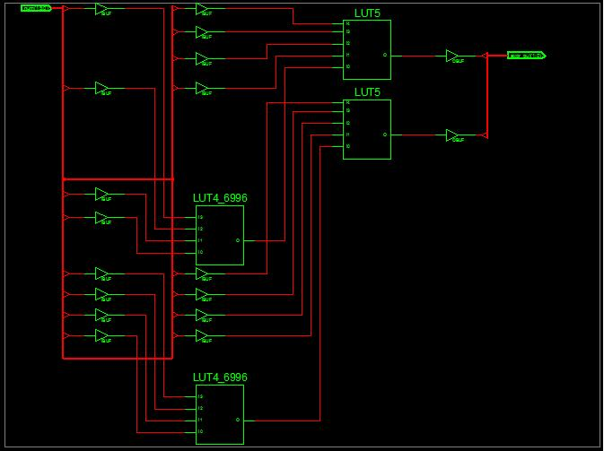
Recursive Functions in VHDL (IV)
Let us see how this code is synthesized
The Technology schematic view of the design is shown below

Slide 48
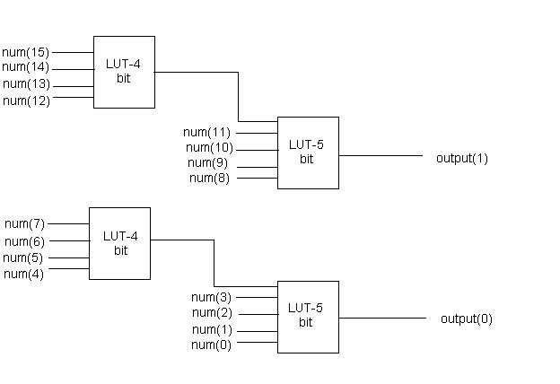
Recursive Functions in VHDL (V)
There are 4 LUT's used to implement the logic-Two 4 input LUT's and two 5 input LUT's.
For implementing the logic relatively more resources are used
This is the disadvantage of recursive functions in VHDL

Slide 49
Recursive Functions in VHDL (VI)
In C and other high level languages recursion is implemented using stack and, there the main issue is stack overflow
In a HDL like VHDL, the resources may get heavily used for even simple codes
The synthesis tool implements the logic by replicating the function in separate hardware component.
If a function calls 10 times itself, then the resources will be used nearly 10 times than that , when an individual block is implemented

Slide 50
Some useful functions

Slide 51
Type conversion
VHDL is strongly depends to data types
Sometimes data type conversion is necessary
For type conversion you should the following library
Use ieee.std_logic_arith.all
Std_logic
bit
Std_logic_vector
bit_vector
Std_logic_vector
integer

Slide 52
Type conversion
Functions:
Function to_stdlogicvector(s:bit_vector) return std_logic_vector;
Function conv_integer(arg:std_logic_vector) return integer;
Function conv_std_logic_vector(arg:integer, size:integer) return std_logic_vector;
Examples
1.
a,b : bit_vector(3 downto 0);
q : std_logic_vector(3 downto 0);
q<= a and b (error)
q<=to_stdlogicvector(a and b); (correct)
2.
a: integer range 0 to 15;
c: std_logic_vector(3 downto 0);
q : std_logic_vector (3 downto 0);
q<= conv_std_logic_vector(a, 4) when conv_integer(c)=8;
Convert to integer

Slide 53
Procedures

Slide 54
Procedures (I)
Procedures are allowed to change the values of the objects associated with its formal parameters
Parameters of procedures may of mode in, out or inout
If no mode is specified the parameter is interpreted as having mode in.
If no class is specified parameters of mode in are interpreted as being of class constant and parameters of mode out or inout are interpreted as being of class variable.
A procedure can return more than one value

Slide 55
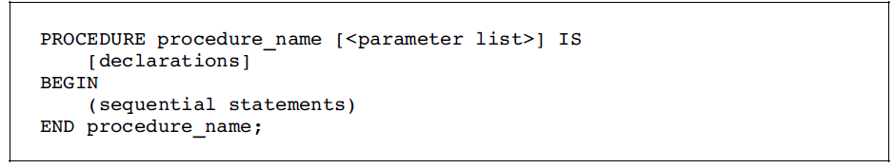
Procedure Syntax
<parameter list> = [CONSTANT] constant_name: mode type;
<parameter list> = SIGNAL signal_name: mode type; or
<parameter list> = VARIABLE variable_name: mode type;

Slide 56
Procedures (II)
Similar to functions, WAIT, SIGNAL declarations, and COMPONENTS are not synthesizable when used in a procedure
BUT, a SIGNAL can be declared, but then the PROCEDURE must be declared in a PROCESS.

Slide 57
Procecdure: Examples
Mode
Procedure ModTwo (X : inout Integer) is
begin
case X is
When 0 | 1 => null;
When others => X := X mod 2;
end case;
end ModTwo;
Here, X is a variable because class has not been specified
procedure dff (signal d: bit_vector; signal clk: bit;
signal q, q_bar: out bit_vector) is
begin
if clk'event and clk = '1' then
q <= d; q_bar <= not(d);
end if;
end dff;
Here d and clk are input because mode has not been specified

Slide 58
Procedure Example
architecture beh of CPU is
procedure mread(
address: in std_logic_vector(2 downto 0);
signal R: out std_logic;
signal S: in std_logic;
signal ADDR: out std_logic_vector(2 downto 0);
signal data: out std_logic_vector(31 downto 0)) is
begin
ADDR <= address;
R <= ‘1’;
data <= read_data;
end procedure mread;
...
end architecture beh;

Slide 59
Procedures (III)
Signals can be passed to procedures and updated within procedures
Signals cannot be declared within procedures
Visibility rules apply here (scope)
Procedure can update signals visible to it even if these signals do not appear in the parameter list.
This is sometimes called as side effect of procedure.
updating signals that do not appear in the parameter list is a poor programming practice.

Slide 60
Procedure Call
compute_min_max(in1, in2, 1n3, out1, out2); -- statement by itself
divide(dividend, divisor, quotient, remainder); -- statement by itself
IF (a>b) THEN compute_min_max(in1, in2, 1n3, out1, out2);
-- procedure call associated to another statement

Slide 61
Concurrent vs. Sequential Procedure Calls
Concurrent procedure call
Procedure calls can be made in concurrent signal assignments
Execution of a procedure is concurrent with other concurrent procedures, Conditional Signal Assignment (CSA) statements, or processes.
The procedure is invoked when there is an event on a signal that is a parameter to the procedure.
Sequential procedure call
Executed within the body of a process.

Slide 62
Example: Concurrent Procedure Call
entity serial_adder is
port(a, b, clk, reset: in std_logic; z: out std_logic);
end entity;
architecture structural of serial adder is
component comb is
port(a, b, c_in: in std_logic; z, carry: out std_logic);
end component;
procedure dff(signal d, clk, reset: in std_logic;
signal q, qbar: out std_logic) is
begin
if(reset =‘0’) then
q <= ‘0’ after 5 ns; qbar <= ‘1’ after 5 ns;
elsif(rising_edge(clk)) then
q <= d after 5 ns; qbar <= not d after 5 ns;
end if;
end procedure;
signal s1, s2: std_logic;
begin
C1: comb port(a=>a, b=>b, c_in=>s1, z=>z, carry=>s2);
dff(clk=>clk, reset=>reset, d=>s2, q=>s1, qbar=>open);
end architecture structural;
behavioral
description

Slide 63
Example: Sequential Procedure Call
entity serial_adder is
port(a, b, clk, reset: in std_logic; z: out std_logic);
end entity;
architecture structural of serial adder is
component comb is
port(a, b, c_in: in std_logic; z, carry: out std_logic);
end component;
procedure dff(signal d, clk, reset: in std_logic;
signal q, qbar: out std_logic) is
...
end procedure;
signal s1, s2: std_logic;
begin
C1: comb port(a=>a, b=>b, c_in=>s1, z=>z, carry=>s2);
process
begin
dff(clk=>clk, reset=>reset, d=>s2, q=>s1, qbar=>open);
wait on clk, reset, s2;
end process;
end architecture structural;

Slide 64
Procedure Location
See the figure presented for Functions
Procedure is usually placed in a PACKAGE
it can also be located in the main code (either in the ENTITY or in the declarative part of the ARCHITECTURE).

Slide 65
FUNCTION versus PROCEDURE

Slide 66
FUNCTION versus PROCEDURE (I)
A FUNCTION has zero or more input parameters and a single return value. The input parameters can only be CONSTANTS (default) or SIGNALS (VARIABLES are not allowed).
A PROCEDURE can have any number of IN, OUT, and INOUT parameters, which can be SIGNALS, VARIABLES, or CONSTANTS. For input parameters (mode IN) the default is CONSTANT, whereas for output parameters (mode OUT or INOUT) the default is VARIABLE.

Slide 67
FUNCTION versus PROCEDURE (II)
A FUNCTION is called as part of an expression, while a PROCEDURE is a statement on its own.
In both, WAIT and COMPONENTS are not synthesizable.
The possible locations of FUNCTIONS and PROCEDURES are the same.
Though they are usually placed in PACKAGES, they can also be located in the main code (either inside the ARCHITECTURE or inside the ENTITY).
When placed in a PACKAGE, then a PACKAGE BODY is necessary, which should contain the body of each FUNCTION and/or PROCEDURE declared in the PACKAGE.

Slide 68
ASSERT

Slide 69
ASSERT (I)
ASSERT is a non-synthesizable statement
The purpose is to write out messages (on the screen) when problems are found during simulation
Depending on the severity of the problem, the simulator is instructed to halt.
The Syntax
The severity level can be: Note, Warning, Error (default), or Failure
The message is written when the condition is FALSE.
ASSERT condition
[REPORT "message"]
[SEVERITY severity_level];

Slide 70
Assert: Example
Suppose we have written a function to add two binary numbers
It was assumed that the input parameters must have the same number of bits
In order to check such an assumption, the following ASSERT statement could be included in the function body
ASSERT does not generate hardware. Synthesis tools will simply ignore it or give a warning.
ASSERT a'LENGTH = b'LENGTH
REPORT "Error: vectors do not have same length!"
SEVERITY failure;

